Slide 1
May 3, 2019 2020 Census: Are You Aware and Ready? Student Voice
OFM
Office of Financial Management

Slide 2
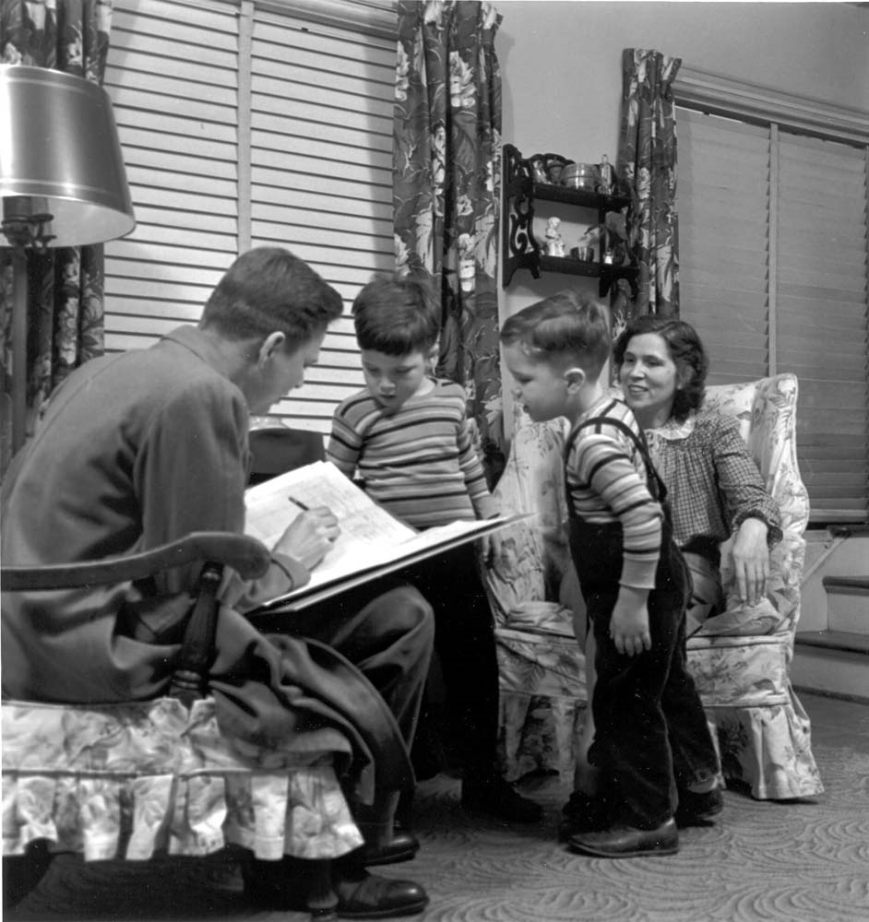
The Decennial Census: What is it?
The census is a self-portrait of the nation, counting everyone living in the country once a decade.
Goal: Count everyone once—only once, and in the right place
When: April 1, 2020
Required by Law/Civic Duty
Notes:
US Census Bureau has been challenged to reduce costs
As the largest peacetime mobilization in a exponentially growing population, the price of the census done the old fashion way is growing and growing
Census changing
Encourage the use of internet as the primary method of self-response
Automate systems
Updating the Master Address File
Automate in person enumeration
Automate enumerator training and administration of their tasks and payroll, etc.
It is short – 10 questions in 10 minutes

Slide 3
Why does it matter?
Collected data is used to:
Distribute political power by redrawing electoral boundaries
Distribute federal and state funds for healthcare, education, highway and rural assistance
Plan where to build schools, roads, healthcare facilities, child care and senior centers, new stores and factories
Inform the decision-making of business, nonprofits, and philanthropies
Notes:
Article I, Section 2 of US Constitution & apportionment – DISTRIBUTE POLITICAL POWER AND ENSURE FAIR REPRESENTATION
Census-derived data influences
Federal, state, and local budget and planning
Business, developer, philanthropies, nonprofits – WHERE TO LOCATE A BUSINESS
$16.7 billion in FY 2016 for Washington, or an average of $2,319 per person
Over 10 years, that’s $5.8 million for every 100 households missed!
Healthcare, Education, Highway and Rural assistance funding
In FY2017, WA got $697 million in funding as part of the Fixing America’s Surface Transportation Bill
Census determines WA states share of federal Coastal Zone Management grants
$39 million in Indian Housing Block Grants and another $600 million in other housing assistance
Education – Special ed, Head Start, School Nutrition
Health – Medicare, Medicaid, CHIP
At the local level:
CITIES GET, at least, $38.21 per person of state shared revenue
COUNTIES, at least, $5.98 per person
AN ACCURATE COUNT OF THE POPULATION IS therefore IMPORTANT FOR THE DISTRIBUTION OF ECONOMIC AND POLITICAL POWER

Slide 4
WA communities win!
In 2016, federal government distributed more than $880 billion for health, education, and infrastructure.
Washington received $16.7 billion in federal funds, or $2,319 per person.
$8.5 billion for health programs
$2.4 billion for education
$1.2 billion for housing
$550 million for rural assistance programs
Nearly $700 million in bridge and highway maintenance & construction
For each 100 households missed, WA could lose $5.8 million over a 10-year period.
Notes:
US Census Bureau has been challenged to reduce costs
As the largest peacetime mobilization in a exponentially growing population, the price of the census done the old fashion way is growing and growing
Census changing
Encourage the use of internet as the primary method of self-response
Automate systems
Updating the Master Address File
Automate in person enumeration
Automate enumerator training and administration of their tasks and payroll, etc.

Slide 5
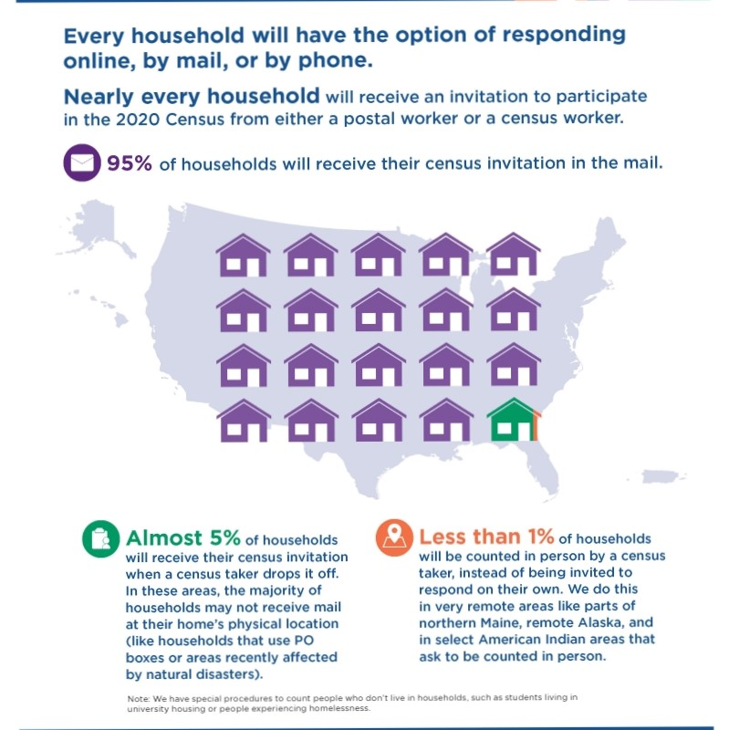
2020 Census introduces online self-response
Respond online via
Computer
Tablet
Smartphone

Slide 6
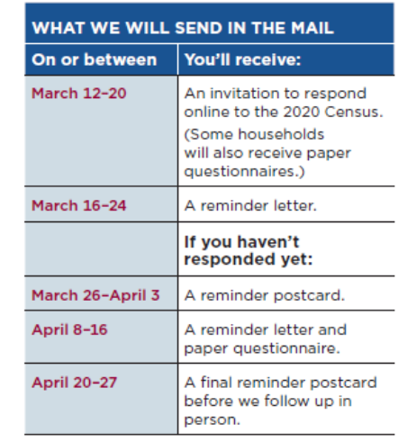
Invitations mailed in March 2020
Mailings staggered over several days in order to:
Spread out the number of users responding online
Provide better service to those who need phone help
Special process for nontraditional households—university housing, senior care centers, homeless
Notes:
ADMIN RECORDS – IRS, Social Security Administration
Spanish paper questionnaire and on tablet
Online and on the phone – 12+ 1
Language guides, glossary, language identification card, video and print guides
In 2010, we had 9 offices… this time only 5
January 2019 – Seattle
Summer 2019 – Olympia, Everett, Tacoma, and Spokane
Partnership specialists (reportedly 28)

Slide 7
Questionnaire – “10 questions in 10 minutes”
Names, sex, age (including date of birth) of each person living at the residence
Relationship of residents to person filing out form
Race/ethnicity
Asks if the residents own or rent
Asks for a contact phone number for follow-up
May include citizenship question

Slide 8
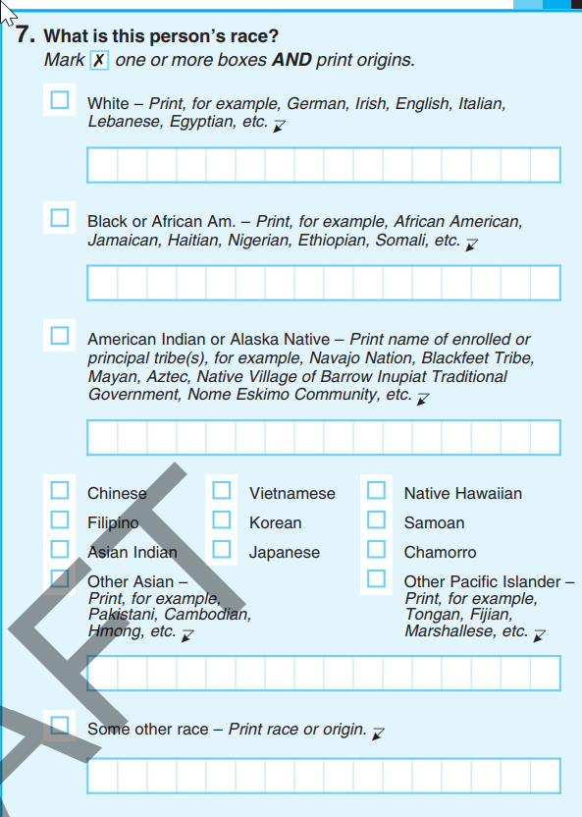
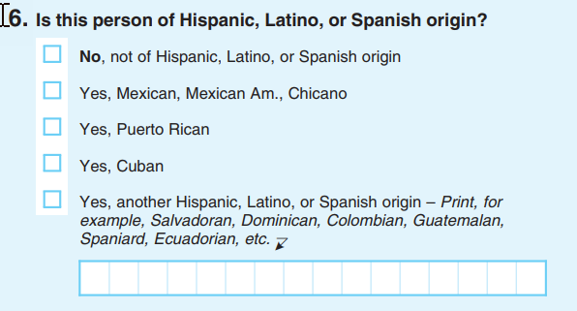
Questionnaire – Race and Ethnicity

Slide 9
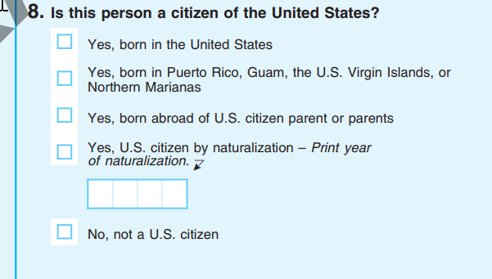
Questionnaire – Citizenship

Slide 10
Multiple languages
English and Spanish for paper questionnaires and field enumeration
Internet self-response in English and 12 non-English languages
Phone self-response and assistance in English, 12 non-English languages, and American Sign Language

Slide 11
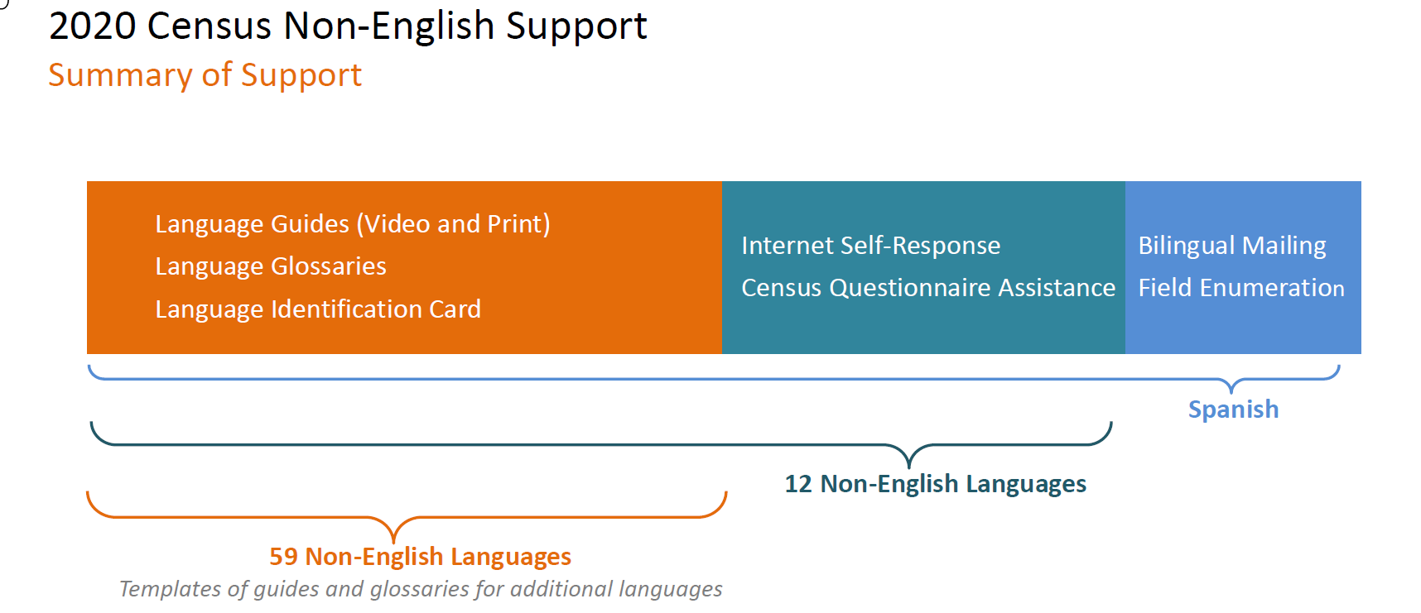
Support for 59 non-English languages

Slide 12
Some people are hard to count
Housing units not in the frame and/or people wanting to remain hidden
Hard to locate
Hard to contact
Hard to persuade
Hard to interview
Participation hindered by language barriers, low literacy, lack of internet access
Suspicious of government, low levels of civic engagement
Highly mobile, people experiencing homelessness, physical access barriers such as gated communities

Slide 13
Challenge: Historically Undercounted
Young children
Highly mobile persons
Persons with complex living arrangements or crowded housing
Racial and ethnic minorities
Non-English speakers
Low income persons
Persons experiencing homelessness or not living in traditional house
Undocumented (and documented) immigrants

Slide 14
WA concerned about an undercount in 2020
Fear, apathy, distrust of government, complicated information scene, difficulty completing
Low internet access in some counties & decreasing mail response to the last census (15 counties—mainly E WA)
Federal funding cut for 2020 Census – tests, swag/advertising, nonresponse follow-up, and offices
Statewide complete count committee, state agency CCC, local CCCs forming

Slide 15
Working together to build and unleash a wave
Create awareness
Mobilize resources
Organize resources
Educate
April 1, 2020 Census Day
Post census day (non-response
Notes:
Complete Count Continues with
Informing
Mobilizing
Organizing
Educati

Slide 16
What others are doing?
Statewide CCC – Gary Locke
State agency CCC
WA Census Equity Fund – Philanthropy NW
WA Census Alliance
Professional/Ethnic/Linguistic CCCs
Counties and cities
Pierce (toolkit)
King–East/South
Seattle
Snohomish
Yakima
Spokane
Wenatchee
Tri-Cities
Whatcom
Thurston

Slide 17
GRASSTOPS MOBILIZATION
75%
Raise awareness of what is at stake
Mobilize communities to recruit and train trusted (and informed) messengers
Maximize self-response (mid-March to end of April)
Foster cooperation (New Construction, Group Quarters, SBE, NRFU)
1%
9%
15%
Notes:
Mission/Vision: Ensure everyone is counted accurately
Leadership: High-level, highly visible, and spanning the spectrum
Function: Provide oversight of outreach – methods, message, and coverage
Enabling a grassroots movement of trusted messengers
Instilling trust and confidence in the process
Making it meaningful: Don’t count yourself out… get counted!
Assisting the process – explanations, FAQ, internet, language
Providing ‘intelligence:’ how the community is feeling/what it needs

Slide 18
What can you do?
Inform yourself – www.ofm.wa.gov/2020census
Do a scan of your community
Who might have difficulty or be afraid? And what can be done?
Make an inventory of mailing lists, newsletters, recurrent communications and events that can be used to spread the word and recruit trusted messengers
Develop Commit-to-the-Census contact lists
ID places with internet access and computers/tablets to host Census Assistance Centers for those who need help
Recruit & educate volunteers who can staff assistance centers and go door-to-door

Slide 19
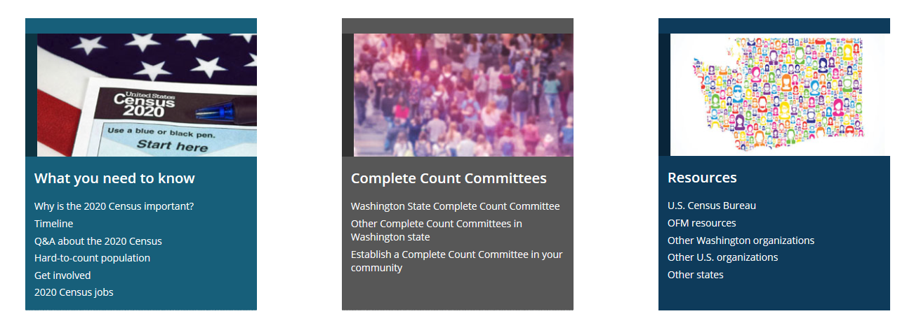
How can OFM help?
Keep you informed - www.ofm.wa.gov/2020census

Slide 20
How can OFM help?

Slide 21
FOR MORE INFORMATION
Lisa McLean
2020 Census Coordinator
Email: 2020census@ofm.wa.gov
Website: www.ofm.wa.gov/2020census

