Slide 1
Analysis for the 2019 Legislative Session: A CTC Student Services Perspective
The Washington State Community and Technical College System
Leadership for unity and strength
Edward Esparza Ph.D.

Slide 2
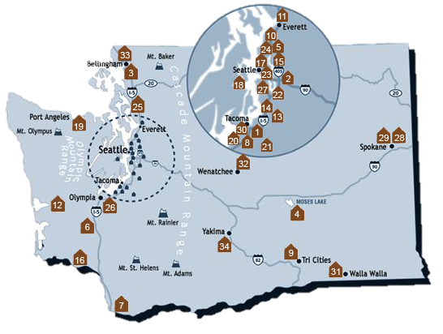
WA Community and Technical Colleges

Slide 3
CUSP and WACTCSA: Legislative Cycle for Change
2019 Legislative Session: 105 days – 2763 bills introduced
1424 bills introduced to the House
1339 bills introduces to the Senate
486 bills passed the House
488 bills passed the Senate
On the House side 274 House bills passed the House
273 House bills passed the Senate
Senate side 215 bills passed the Senate/212 Senate bills passed the House

Slide 4
State Board Role with the Legislature:
Among its specific responsibilities are to:
Prepare a single system operating budget request and capital budget request for consideration by the Legislature.
Disburse capital and operating funds appropriated by the Legislature to the college districts.
Ensure that each college maintains an open door policy and offers the educational, training, and service programs specified by law.

Slide 5
State Board Role cont...
Administer criteria for establishment of new colleges and for the modification of district boundary lines.
Establish minimum standards for the operation of community and technical colleges.
Prepare a comprehensive master plan for community and technical college education.
Encourage innovation, coordinate research, and disseminate research findings.

Slide 6
2019-21 College System Leg. Priorities
Faculty compensation: ($68 million)
“Guided Pathways — a redesign of course sequencing and student advising. This includes expanded outreach and partnerships with K-12 and universities to increase enrollment and success of diverse students ($86 million)
Capacity expansion in high-demand programs like allied health, advanced manufacturing and information technology ($35 million)
Capital Budget request of $627 million dollars (funding 37 major projects and 29 minor projects at all Washington State CTS’s

Slide 7
WACTCSA Legislative Priorities
New Hope for Previously Incarcerated Students:
The State should support legislation that limits disclosure of a student’s criminal past on social and human service applications; like housing and food assistance.
This action can increase employment and housing opportunities, reduce recidivism, and decrease racial disparity in the criminal justice system.
Further, this action will help students enroll in college and support academic completion.

Slide 8
Textbooks and Open Educational Resources (O.E.R.s) Affordability and Accessibility
The legislature should establish greater incentives and funding for educators and professors to facilitate OER development; an effective and proven process. CTC students are continually concerned about prohibitive costs of educational resources for most courses offered in the CTC system.
CTC students want equitable access to affordable content to support their education; when not available, students seek other alternatives or do not purchase books. We appreciate former legislative action to support the development of OERs but more is needed.

Slide 9
College Affordability
The legislature should expand access to in-state tuition programs and adopt an innovative model that supports academic completion for CTC students.
A high school diploma is no longer enough to give a person equal access to quality jobs; studies show that by 2020 65% of all jobs in the U.S. will require post-secondary education.
To meet this demand, every resident of Washington State should have an equitable opportunity to pursue higher education. This makes our workforce more competitive and strengthens our State’s economy

Slide 10
System Issue: Address College Campus Food Insecurity
The State Board for Community and Technical Colleges should create a study focused on developing best practices and policies focused on CTC college campus food pantries and electronic debit systems for statewide adoption.
Schools currently do not have guidance on partnering and/or networking with local agencies.
Additionally, students are more in need of access to EBT transactions; as campus stays are longer due to spread out course schedules. Addressing barriers to low-income student’s ability to obtain food on campus is an access issue for academic success and a best practice model can address this.

Slide 11
Legislative Advocacy Day: January 24, 2019
Introduction of the capital and campus grounds
84 Students
70 Appointments
21 colleges

Slide 12
Summary: What we got
Guided Pathways Funding: $32.1 million ($2m for FY20; $30.1 million for FY21) to implement Guided Pathways at all CTCs.
Student Assistance Grants: $1.5 million ($750,000 each year) for emergency assistance grants for students experiencing unforeseen emergences or situations that affect ability to attend classes (2SHB 1893).
Homeless College Students: $548,000 ($200,000 for FY20; $348,000 for FY21) is provided for a pilot program that assists students experiencing homelessness or who were in the foster care system (2SSB 5800).

Slide 13
Summary: HB 2158 - Our Big Win
Washington College Grant: $190 million for financial aid. The State Need Grant is replaced by the Washington College Grant (WCG). These new investments will:
Increase awards with tuition to hold students harmless from tuition and fee increases.
Reduce the waitlist by one-third in 2019-20 and eliminate the waitlist in 2020-21.
Expand eligibility from 70% to 100% of median family income in 2020-21.

Slide 14
Summary: What we lost
Text book affordability HB 1702
Passed the House
Passed the Senate
Passed Ways and Means
No fiscal note (no cost)
Did not get a floor vote………………

Slide 15
What we need to do next..
Up our Student Voice Game!
Re-energize WACTCSA
We need to saturate the legislature to assure that they know that CTC students matter, as we are 370,000 strong!
We need think about Diversity Equity and Inclusion in our work
We need to work even closer with the state board and our Legislative Affairs office
We need to make sure HB 1702 is one of our agenda items for next year – its about equity and inclusion.

Slide 16
Thank you owed…
Thank SBCTC Executive Director, Jan Yoshiwara and system advocates i.e. SPSCC President, Dr. Tim Stokes, who worked everyday advocating for State Need Grant...
Thank our Lt. Governor, Cyrus Habib who said no more amendments and made the legislature vote on HB 2158 at 4 am in the morning…
Thank our CUSP staff for giving students a space and voice to do this work…
Thank the SBCTC Legislative Director, Arlen Harris who literally fought in the hallways with the legislature for full funding of State Need grant…

Slide 17
Questions ??
Joe Holliday, jholliday@sbctc.edu, 360-704-4334
Ruben Flores, rflores@sbctc.edu, 360-704-3929
Edward Esparza, eesparza@sbctc.edu, 360-704-4319
Nanette Angel, nangel@sbctc.edu, 360-704-4315
Arlen Harris, aharris@sbctc.edu, 360-704- 4394
Note: All material licensed under Creative Commons Attribution 4.0 International License.

